Slide 1

SDET Course
Design Patterns - Observer

Slide 2
3 Types of Design Patterns
Creational
Singleton
Builder
Prototype
Factory Method
Abstract Factory
Structural
Adapter
Composite
Proxy
Flyweight
Bridge
Facade
Decorator
Behavioral
Strategy
Observer
Command
Memento
State
Template Method
Mediator
Chain of Responsibility
Interpreter
Visitor
Iterator

Slide 3
Agenda
Description
Diagram
Code sample (Java)
Use cases

Slide 4

Description
Introduction - The Broadcasting Teacher

Slide 5
Description
The Observer design pattern is a behavioral design pattern that focuses on establishing a one-to-many dependency between objects so that when one object changes state, all its dependents are notified and updated automatically. This pattern is primarily used to implement distributed event handling systems, in which the object that emits the event is the "subject", and the objects that receive the event are "observers". The Observer pattern allows for the objects to remain loosely coupled, whereby the subject doesn't need to know anything about the observers, other than that they implement a certain interface. This design principle enhances flexibility and reusability, making it easier to add new observers without modifying the subject or other observers. This pattern is widely used in various programming environments for implementing event management systems, such as graphical user interfaces where actions like button clicks are handled in an efficient manner.

Slide 6
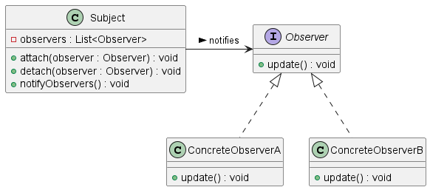
Class Diagram

Slide 7
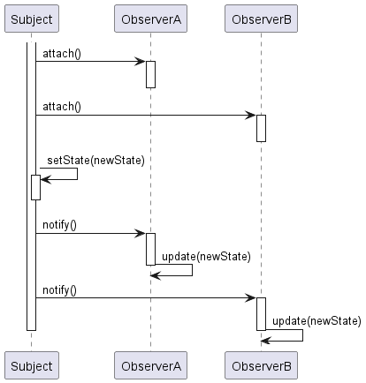
Sequence Diagram

Slide 8
Code Sample

Slide 9
Use cases
General
Event Management Systems
Financial Markets
Weather Monitoring
In Test Automation
Logging Mechanism
Test Result Reporting

Slide 10
Happy Coding

